Slide 1
EXTRACT RESTAURANT ASPECT WORDS BY USING WORD2VEC MODEL FROM YELP REVIEWS
Penghao Wang

Slide 2
Outline
Introduction
Definitions, Scope, Significance and Research Question
Assumptions, Limitations, and Delimitations
Review of Relevant Literature
Four papers
Framework and Methodology
Quantitative framework, data, test data summary, and researcher bias
System overview and Design
Clean and load data
Word2vec model, Baseline Model
Cluster selection, and test and analyze results
Research data and results
Analyze Word2vec, baseline model and test on the test data
Conclusions and Recommendations

Slide 3
Definitions
Aspect words
The words of terms that reflect the aspect of the entities (Mukherjee & Liu, 2012).
Opinion mining tool
a tool that processes a set of search results for a given item, generating a list of product attributes (quality, features, etc.) and aggregating opinions about each of them (Dave, Lawrence, & Pennock, 2003)
Aspect extraction
A subtask of sentiment analysis that consists of identifying opinion targets in opinionated text. (Poria, Cambria, & Gelbukh, 2016)
Word embedding
Natural language processing technique to map words or phrases into a vector of numbers.
Notes:
1.an opinion mining tool would process a set of search results for a given item, generate a list of product attributes and collect opinions about each of them
2. Capturing sentiment using natural language processing
3. Give the computer the ablility to learn without specific programming

Slide 4
Scope
Test the stat-of-art method for extracting aspect words .
The performance of word2vec model for extracting different aspect words .
Topic model, clustering, and word2vec model

Slide 5
Significance
For a restaurant, reviews could be used to improve the food, service, and other aspects.
For the customers, the reviews help gather other consumers’ opinions about the restaurants.
Notes:
However, it is impossible for them to read all of the reviews and make a decision. So point 2.
However, overall ratings have a drawback, it won’t give the customer details about the restaurants.
For instance, if I want to choose a R based on servvice. By using the overall score, I can’t get these information.

Slide 6
Research Question
Whether it is possible to extract words or terms that reflect restaurants aspects from the Yelp reviews by using word2vec model?
In other words, what is the performance of word2vec model for extracting the aspects words ?
Food, service, ambiance, and price (Sajnani, et al., 2012).
“Love this place. I have been there twice and the food has been outstanding. try the catfish - it is yummy.”
“food” and “catfish”

Slide 7
Assumptions
The datasets contain the correct information about the reviews and restaurants.
The restaurants which shared the same Restaurants ID were the same restaurants.

Slide 8
Limitations
English reviews.
Restaurants only.
Focusing on the reviews of the restaurants.
Cities in Canada and United States.

Slide 9
Delimitations
The study was not focusing on analyzing the pictures.
The seasonal trend was out of the scope of this study.
The study was not focusing on analyzing the location of the restaurants.
The research was not focusing on short reviews (Less than four words).

Slide 10
Review of Relevant Literature
Explicit vs Implicit
Subtasks of aspects extraction
Word embedding
Word2vec Model
Notes:
im pl 'cit
ex pli 'cit

Slide 11
Explicit vs Implicit
M. Hu and Liu (2004) studied summarization of customer review based on product features.
Explicit and Implicit
“The size of the laptop is OK.”
“The laptop can’t fit in my backpack.”

Slide 12
Subtasks of aspects extraction
Popescu and Etzioni (2005) described the problem of extraction opinions or features as four following subtasks:
Identify product features.
Identify opinions regarding product features.
Determine the polarity of opinions.
Rank opinions based on their strength.

Slide 13
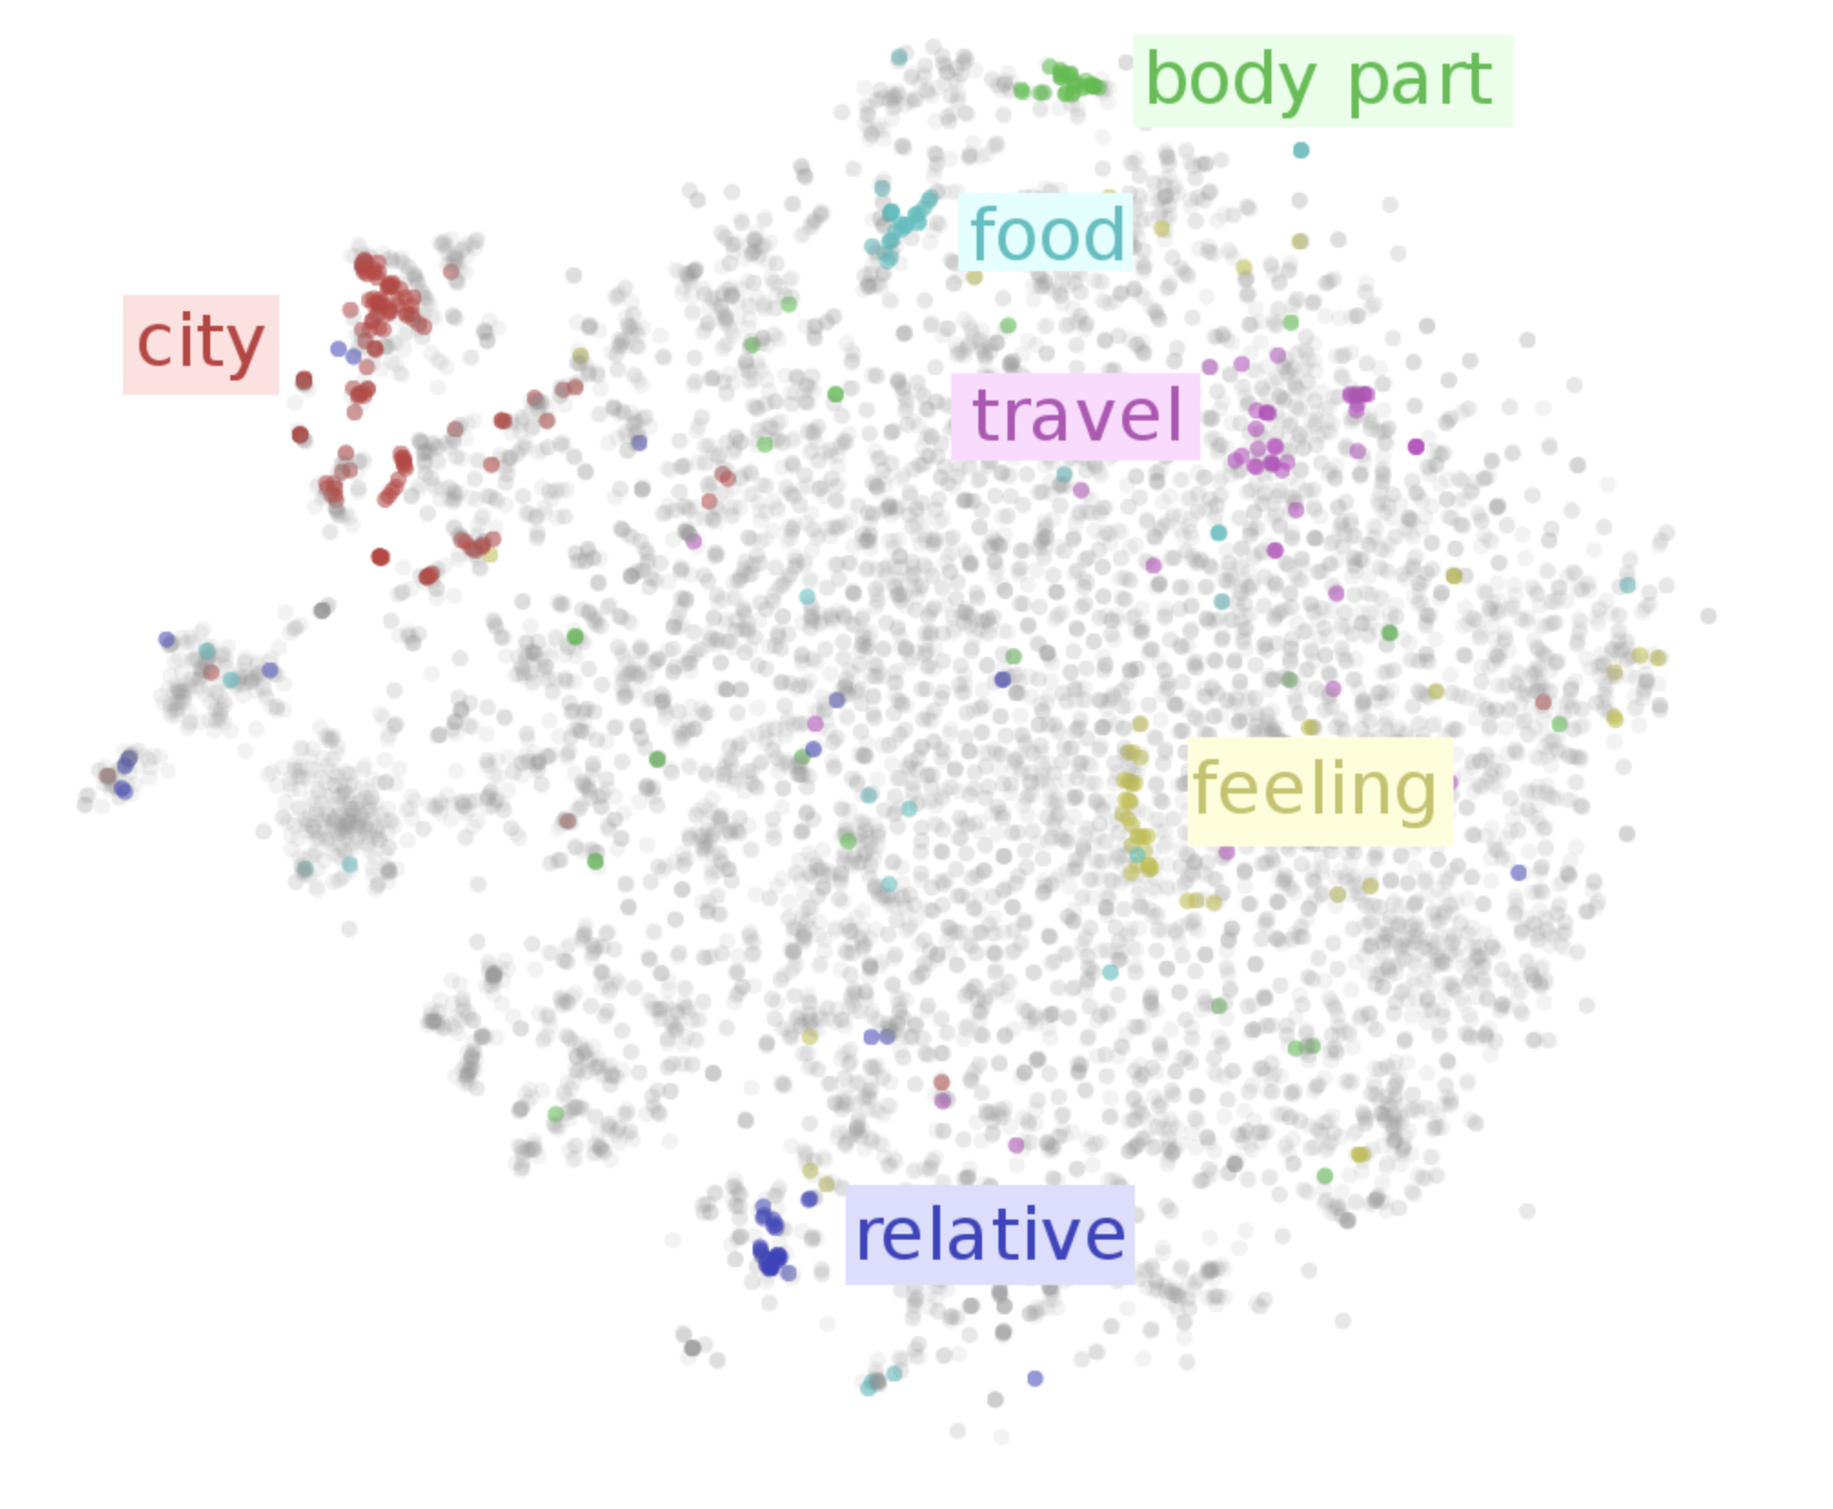
Word embedding
Represent words into continuous vector space where semantically similar words are nearby each other

Slide 14
Word embedding
Distributional Hypothesis
Words that are used and occur in the same contexts tend to purport similar meanings (Harris, 1954)
A word is characterized by the company it keeps (Firth, 1957)
Count-based vs Predictive Model
Latent Semantic Analysis (Hofmann, 1999)
Word2vec

Slide 15
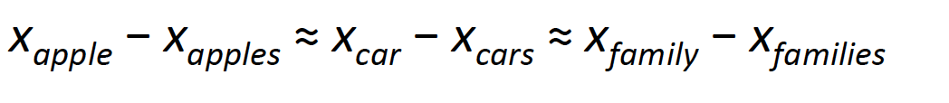
Word2vec Model
Continuous Bag-of-Words model (CBOW)
Tries to predict the central words by using context words or neighbor words
Maximize the object function
Skip-Gram model
Predict the surrounding words by the given words

Slide 16
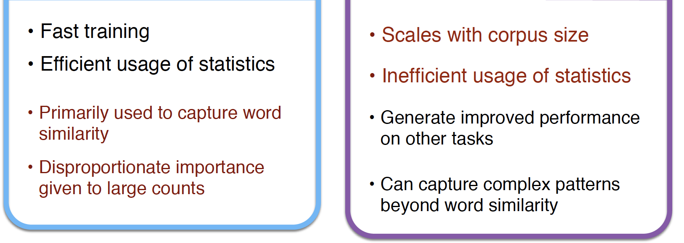
Predict, don’t count!
Baroni, Dinu, and Kruszewski (2014) conducted a study to compare the count-based approaches and the predictive models
They stated that “the predict models are so good that, while the triumphalist overtones still sound excessive, there are very good reasons to switch to the new architecture.”

Slide 17
FRAMEWORK AND METHODOLOGY
Extraction problem could be split into different sub-problems
What are the grammatical tagging of the aspect terms and how to define them?
How to find similar aspects words in a large corpus?
How to cluster different words?
How to test the performance of the methodology

Slide 18
Define the grammatical tagging
Change case of the text.
Use Stanford Parser to tag each word
Combined with nltk package
If there are two nouns connected, combine them and tag as noun.
For instance, “They also had Stella Cider and Moscow mules!”

Slide 19
Extract aspects and clustering
Word2vec model
python package gensim
Standard k-Means approach vs hierarchical approach
Large amount of the data
Hierarchical approach performed better than standard k-Means based on running time

Slide 20
Clustering
Selected singular or plural nouns.
Clustered the words into different groups by using cluster algorithm.
In the cluster, sorted the noun or nouns by frequency.
Manually selected which clusters remained and which did not.

Slide 21
Test performance
1076 manually labeled reviews will be used.
Use the result to calculate the precision, recall and F-1 score.
Notes:
Talk more details on the labeled data later

Slide 22
Baseline Model
LDA model.
Both word2vec model and LDA model are unsupervised models.
Count-based vs Predictive model
Step 1-3 were same as previous
Step 4-7
Used Python package gensim to train LDA model on the reviews.
Transform words into 200 dimension vector.
Clustered the words into different groups
Manually decided which cluster remained and which did not
Use the test data to calculate the precision, recall, and F-1 score

Slide 23
Programming Method
The program was based on Python
Numpy, gensim, nltk, tensorflow, and sklearn

Slide 24
Data
Yelp dataset challenge ("Yelp Dataset Challenge", 2016)
About 1.7 million reviews about restaurants
591 thousand tips by 552 thousand users
77 thousand businesses. The final data contained about 1.7 million reviews.

Slide 25
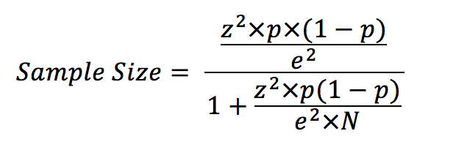
Test Data
Test data: 1,076 random reviews
confidence level is 90%, the z-score is 1.65
The margin of the error is e parameter
Population size is N parameter
Four people manually labeled the data.
Four aspects
Disagreement
Notes:
Talk more details
-disagree- four choices
- or and, myself, group meeting

Slide 26
Researcher Bias
Limitation of test data
POS accuracy
The version of nltk Python package is 3.2.2. The version of Stanford POS tagging tool is 3.7.0
Selecting the relative clusters

Slide 27
SYSTEM OVERVIEW AND DESIGN
Load and clean the data.
Train the word2vec model. (Mikolov, Chen, et al., 2013)
Cluster the words based on the vector of the word.
Select useful cluster words and create the final dictionary.
Represent the word in vectors by using baseline model.
Cluster words and selected relevant clusters by using baseline model.
Test the results and analyze the results.

Slide 28
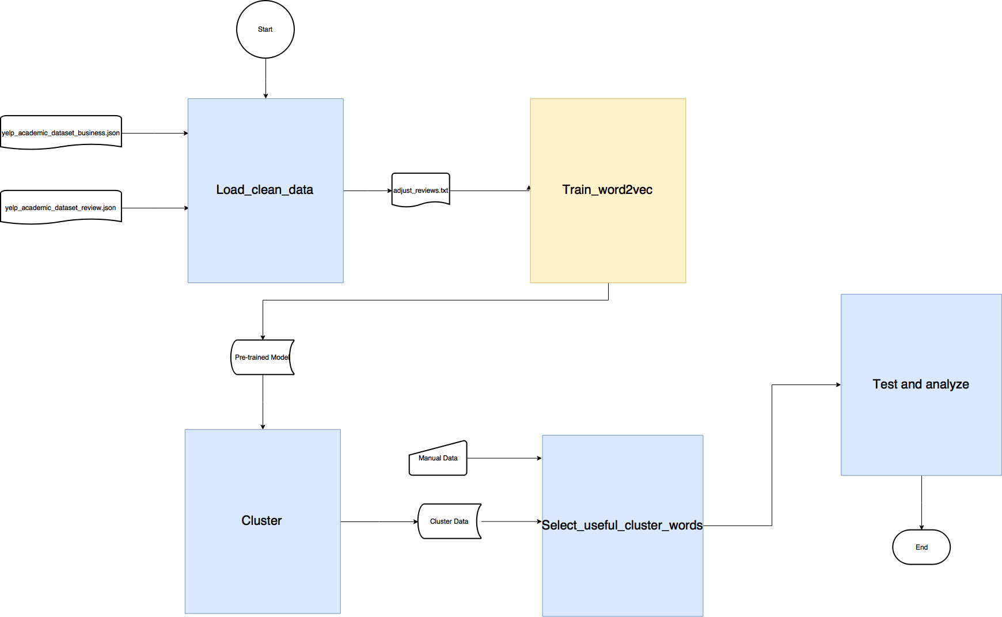
Overview

Slide 29
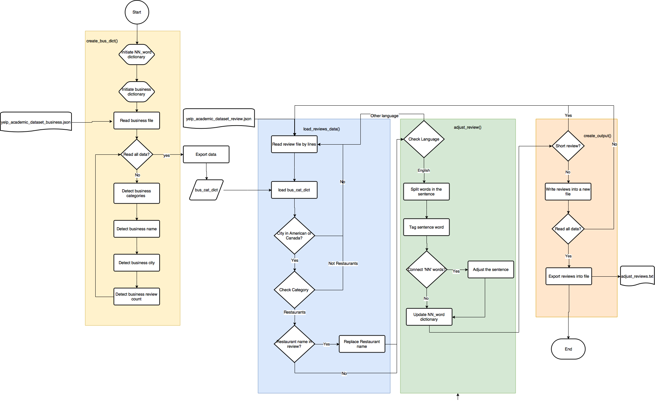
Load and Clean the Data

Slide 30
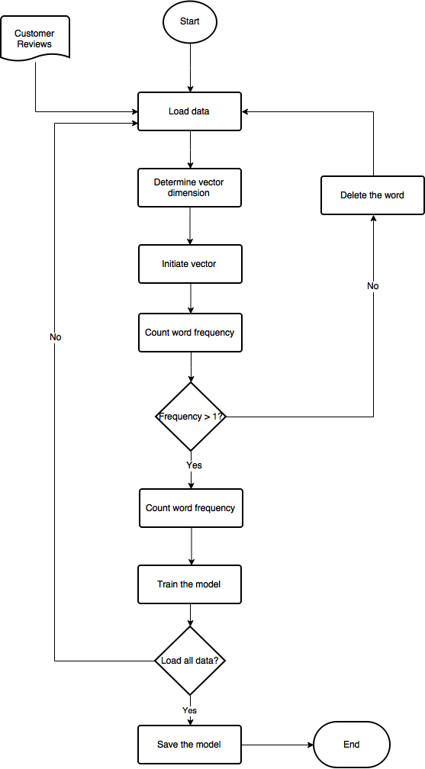
Train the Word2vec Model
Load the data
Initiate the vectors
Train model
Assign value
Save model

Slide 31
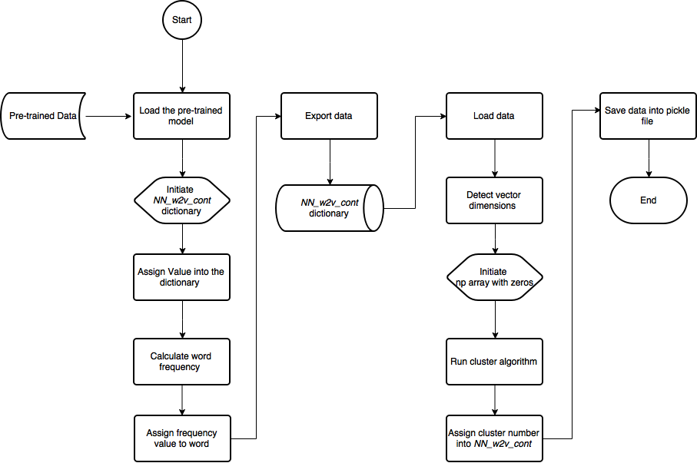
Create Cluster of the Words

Slide 32
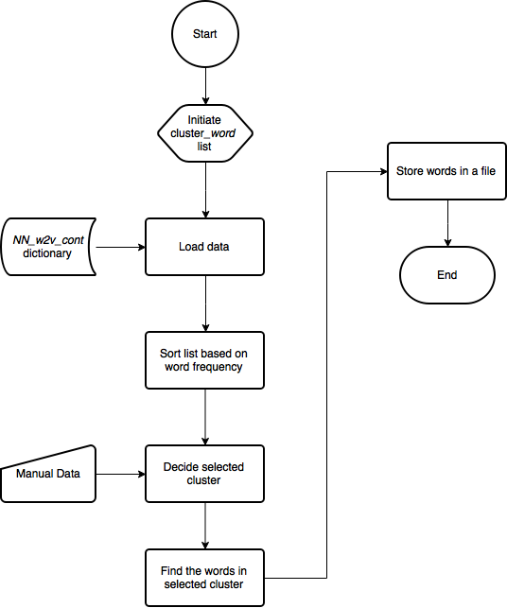
Select the Relevant Cluster from Word2vec Model

Slide 33
Select the Relevant Cluster from Word2vec Model (continued)
For each cluster, the program sorted words in the cluster by the word frequencies.
Selected the top 20 words
For each words in the cluster, check following:
Noun? (if no, assign zero, if yes, continue)
food or not? (food portion or food quality)
Staff?
Ambience?
Price or fees?
Service?
After checking top 20 words and assigned the value, the author added the value together and divided it by 20.
larger than 60%, then selected the cluster
Notes:
talk about less of 20.
60% - bias
to find the best one -- try everyone, but not the aim
no trained data
-0 or 1 question but not 60%

Slide 34
Select the Relevant Cluster from Word2vec Model (continued)
Example
['eggs', 'egg', 'pancakes', 'gravy', 'waffles', 'waffle', 'crepe', 'hash', 'omelet', 'benedict', 'biscuits', 'grits', 'pancake', 'omelette', 'biscuit', 'browns', 'skillet', 'quiche', 'scramble', 'hash_browns', 'hashbrowns’]
Score > 60%.
Selected.
['friend', 'husband', 'wife', 'boyfriend', 'mom', 'daughter', 'son', 'girlfriend', 'sister', 'mother', 'dad', 'brother', 'fiance', 'partner', 'father', 'cousin', 'companion', 'companions', 'partners']
Score < 60%.
Not selected.

Slide 35
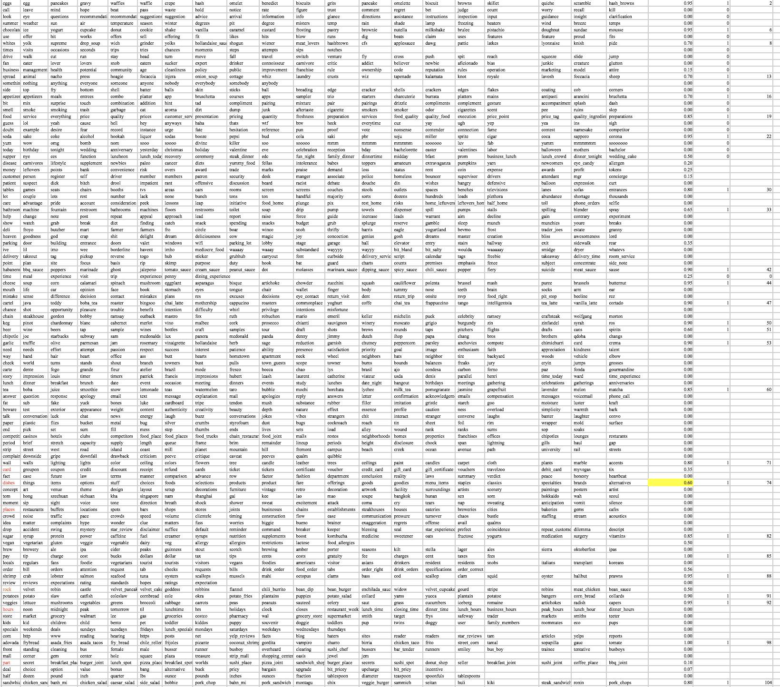
Select the Relevant Cluster from Word2vec Model (continued)

Slide 36
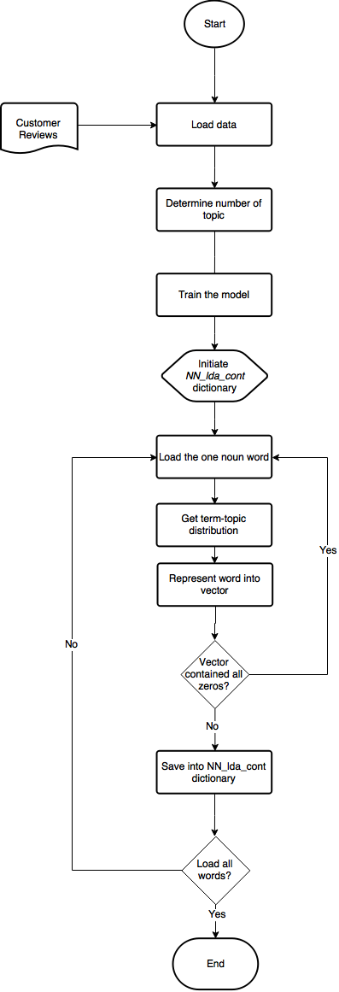
Represent the Word in Vectors by Using Baseline Model
Load the data
Train the model
Initialize zeros vectors
Transform words to vectors.
Use term-topic distribution
Example:
Word “A” has term- topic distribution
(topic 1: 0.2, topic 10: 0.4, topic 199: 0.4)
The vector should be [0, 0.2,0….0,0.4,…,0.4]
Clean the vector contained all zeros

Slide 37
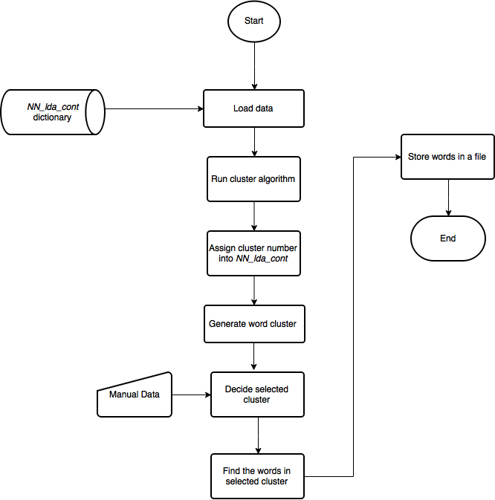
Cluster Words and Select Relevant Clusters by Using Baseline Model
Same cluster algorithm
Same selection process

Slide 38
Test the Results and Analyze the Results
Demonstrate features of the word2vec model
tensorflow package
t-Distributed Stochastic Neighbor Embedding technique (Maaten & Hinton, 2008)
Precision, recall, and F-1 score

Slide 39
RESEARCH DATA AND RESULTS
Analyze Word2vec Model Result
Analyze Baseline Model
Test on Test Data
Word2vec vs. Baseline
Word2vec (high frequency words) vs. Baseline

Slide 40
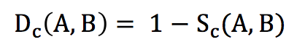
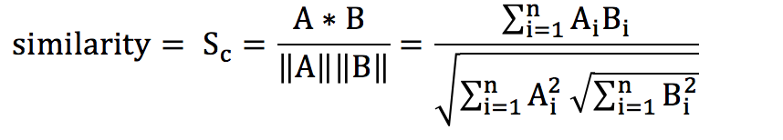
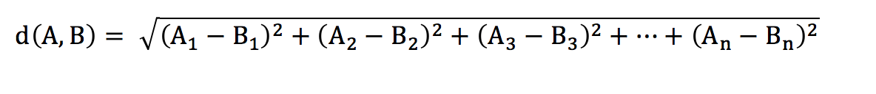
Analyze Word2vec Model Result
Use t-Distributed Stochastic Neighbor Embedding (Maaten and Hinton, 2008) to visualize
Calculate similarity of the high dimensional vector
Cosine distance
Euclidean distance
Notes:
U_cli_dean

Slide 41
Analyze Word2vec Model Result
Author's expectation
Food
Service
Ambience
Price

Slide 42
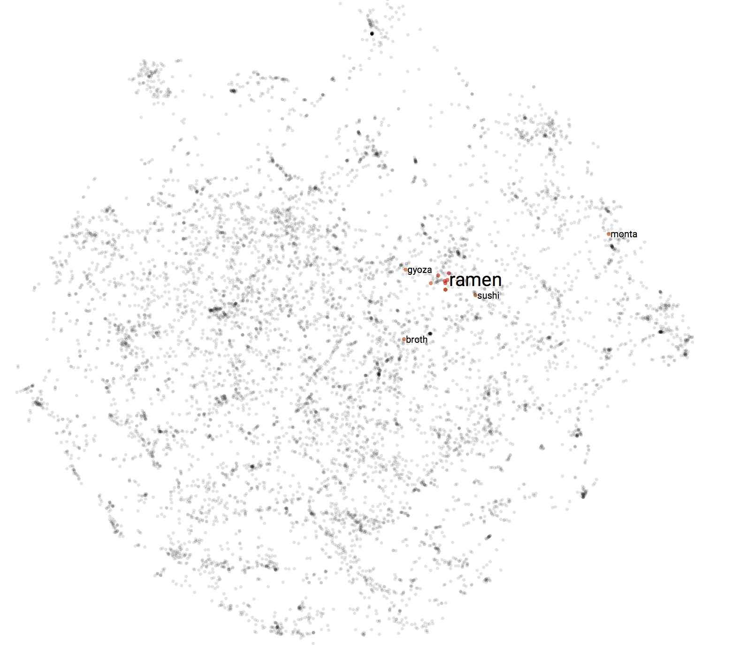
Analyze Word2vec Model Result
Similar words of “ramen” in 2D

Slide 43
Analyze Word2vec Model Result
Top 10 similar words of “ramen”
Similar words of “ramen” | Cosine distance | Euclidean distance
pho | 0.279 | 0.747
tonkotsu | 0.338 | 0.823
tonkatsu | 0.340 | 0.824
udon | 0.351 | 0.838
broth | 0.424 | 0.921
noodle | 0.443 | 0.942
monta | 0.448 | 0.946
chashu | 0.451 | 0.949
sukiyaki | 0.451 | 0.960
sushi | 0.460 | 0.972

Slide 44
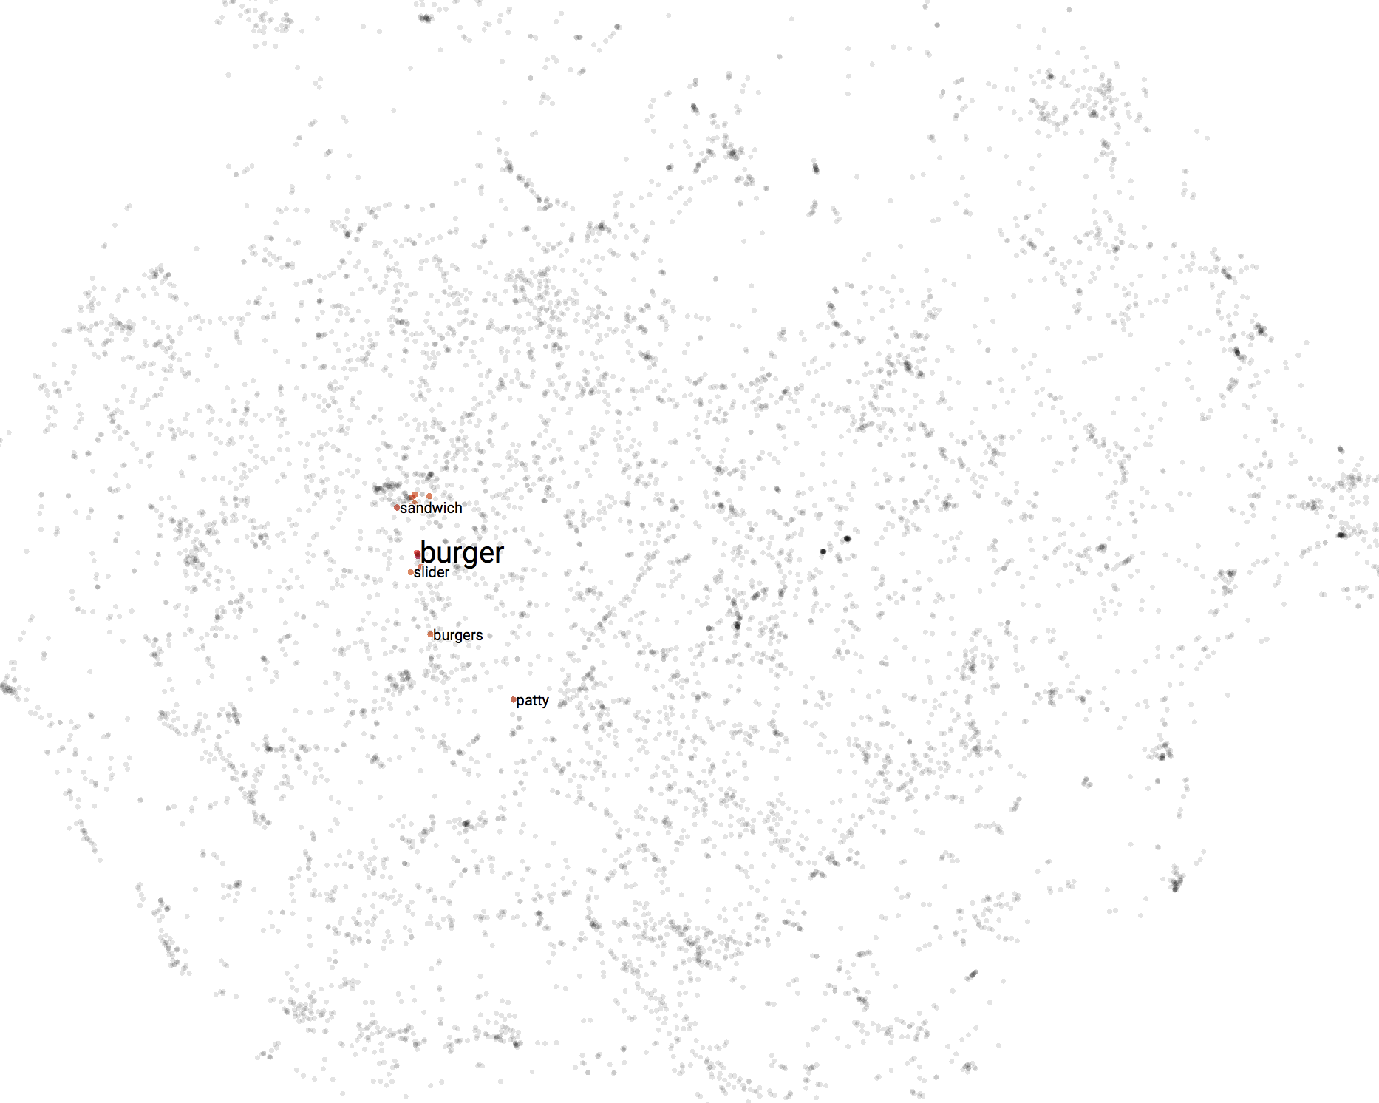
Analyze Word2vec Model Result
Similar words of “burger” in 2D

Slide 45
Analyze Word2vec Model Result
Top 10 similar words of “burger”
Similar words of “burger” | Cosine distance | Euclidean distance
Hamburger | 0.221 | 0.665
Cheeseburger | 0.238 | 0.689
Sandwich | 0.353 | 0.840
Hotdog | 0.383 | 0.875
Patty | 0.383 | 0.875
Veggie_burger | 0.399 | 0.894
Turkey_burger | 0.412 | 0.907
Chicken_sandwich | 0.413 | 0.909
Burgers | 0.419 | 0.916
blt | 0.423 | 0.920

Slide 46
Analyze Word2vec Model Result
Top 10 similar words of “beverage”
Similar words of “beverage” | Cosine distance | Euclidean distance
drink | 0.245 | 0.700
Beverages | 0.281 | 0.750
Drinks | 0.441 | 0.940
Soda | 0.460 | 0.960
Mimosa | 0.499 | 0.999
Beer | 0.505 | 1.005
Tea | 0.536 | 1.035
libation | 0.549 | 1.048
coffee | 0.569 | 1.067
sodas | 0.578 | 1.075

Slide 47
Analyze Word2vec Model Result
Words that were similar to “beverage” should be far from the words that are like “ramen” and “burger”
Cosine distance between “drink” and “beverage” was 0.245
Cosine distance between “drink” and “burger” was 0.9
Cosine distance between “drink” and “ramen” was 0.793

Slide 48
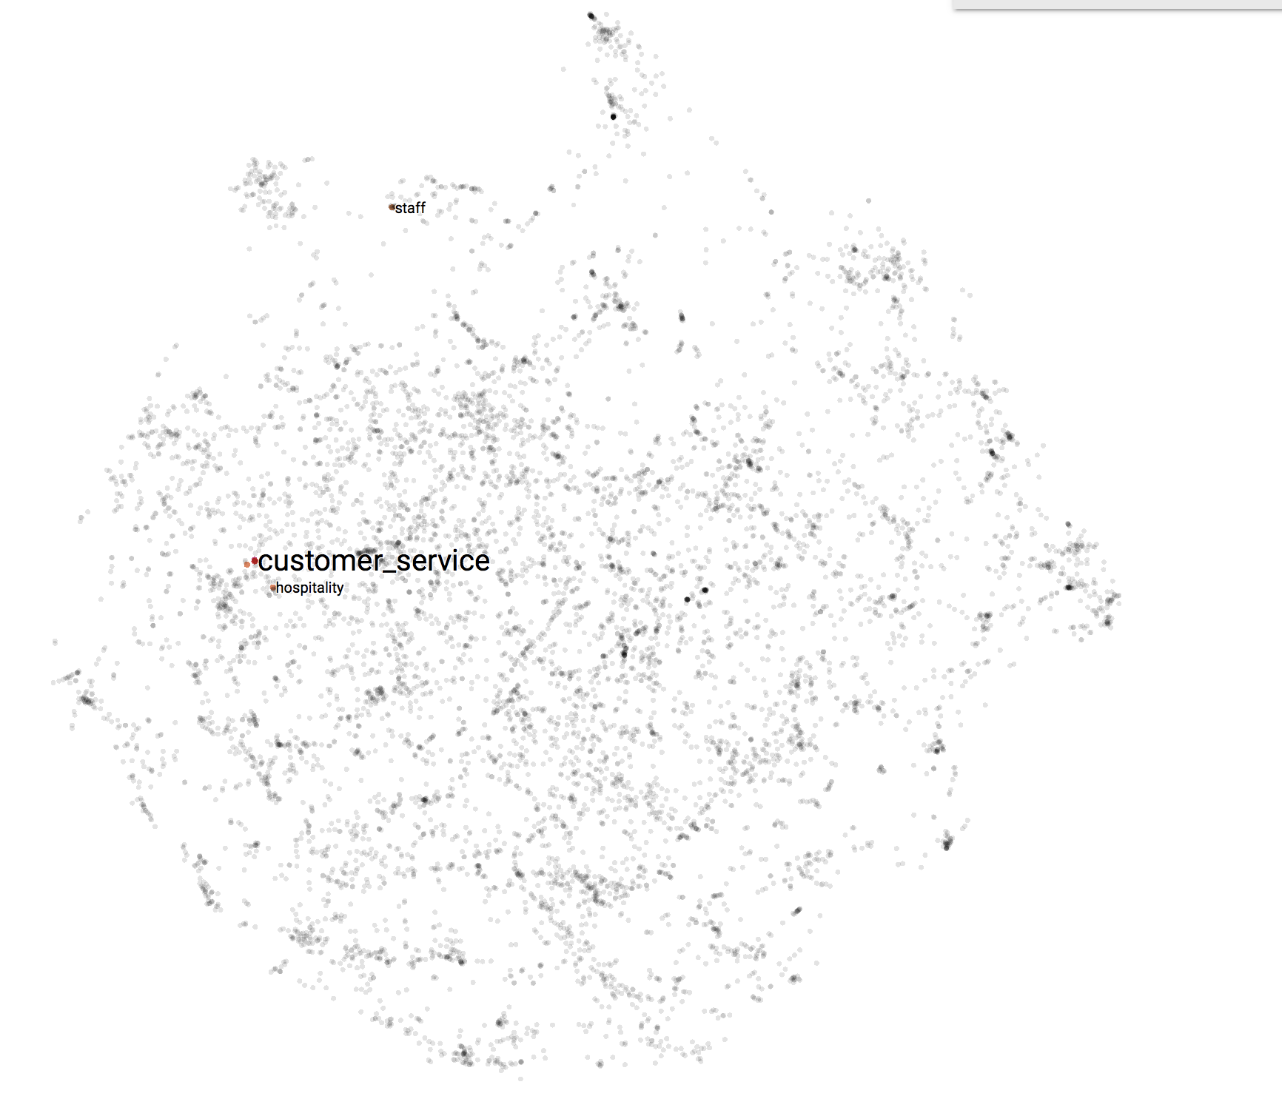
Analyze Word2vec Model Result
Similar words of “customer_service” in 2D

Slide 49
Analyze Word2vec Model Result
Top 10 similar words to “customer service”
Similar words of “Customer_service” | Cosine distance | Euclidean distance
service | 0.191 | 0.618
services | 0.281 | 0.750
hospitality | 0.424 | 0.920
attitudes | 0.430 | 0.928
staff | 0.463 | 0.963
attitude | 0.597 | 0.997
management | 0.502 | 1.002
waitstaff | 0.533 | 1.032
professionalism | 0.537 | 1.036
Beer_selection | 0.546 | 1.045

Slide 50
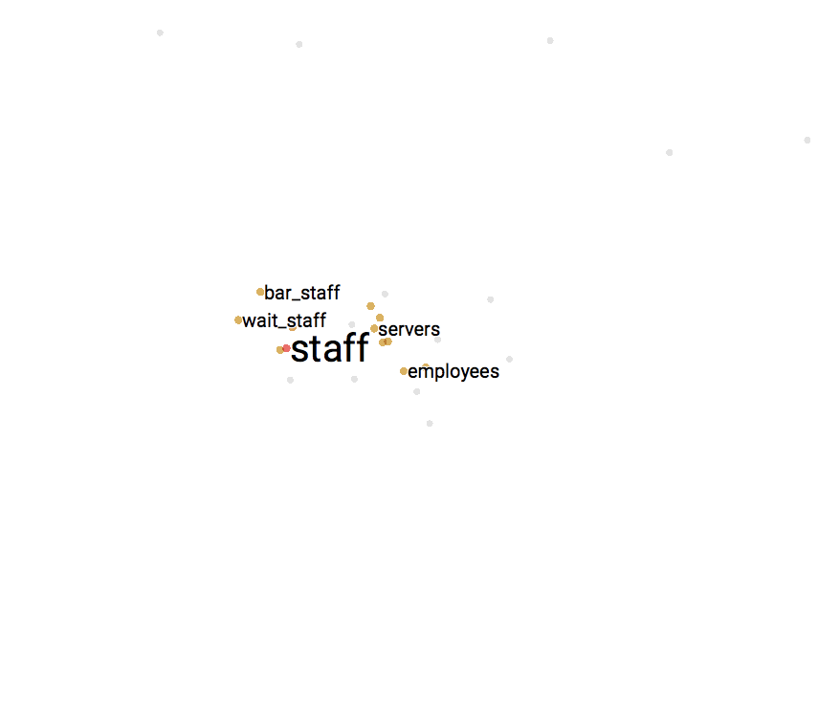
Analyze Word2vec Model Result
Similar words of “staff” in 2D

Slide 51
Analyze Word2vec Model Result
Top 10 similar words to “staff”
Similar words of “staff” | Cosine distance | Euclidean distance
Waitstaff | 0.154 | 0.555
staffs | 0.292 | 0.776
servers | 0.310 | 0.787
employees | 0.313 | 0.792
Wait_staff | 0.326 | 0.808
Bar_staff | 0.343 | 0.828
bartenders | 0.376 | 0.867
baristas | 0.377 | 0.868
service | 0.397 | 0.891
waiters | 0.407 | 0.902

Slide 52
Analyze Word2vec Model Result
Top 10 similar words of “ambience”
Find abbreviations like “deco”
The cosine distance between the word “deco” and “decoration” is 0.431
Similar words of “ambience” | Cosine distance | Euclidean distance
ambiance | 0.019 | 0.194
atmosphere | 0.071 | 0.376
environment | 0.180 | 0.600
decor | 0.181 | 0.602
setting | 0.284 | 0.754
interior | 0.299 | 0.773
layout | 0.384 | 0.877
scenery | 0.407 | 0.902
lighting | 0.420 | 0.917
surrounding | 0.422 | 0.918

Slide 53
Analyze Word2vec Model Result
Top ten words similar to “fee”
Similar words of “fee” | Cosine distance | Euclidean distance
fees | 0.302 | 0.778
gratuity | 0.465 | 0.964
charge | 0.486 | 0.986
upcharge | 0.487 | 0.986
minimum | 0.517 | 1.017
charges | 0.530 | 1.030
corkage | 0.535 | 1.035
taxes | 0.560 | 1.059
cost | 0.561 | 1.064
policy | 0.566 | 1.071

Slide 54
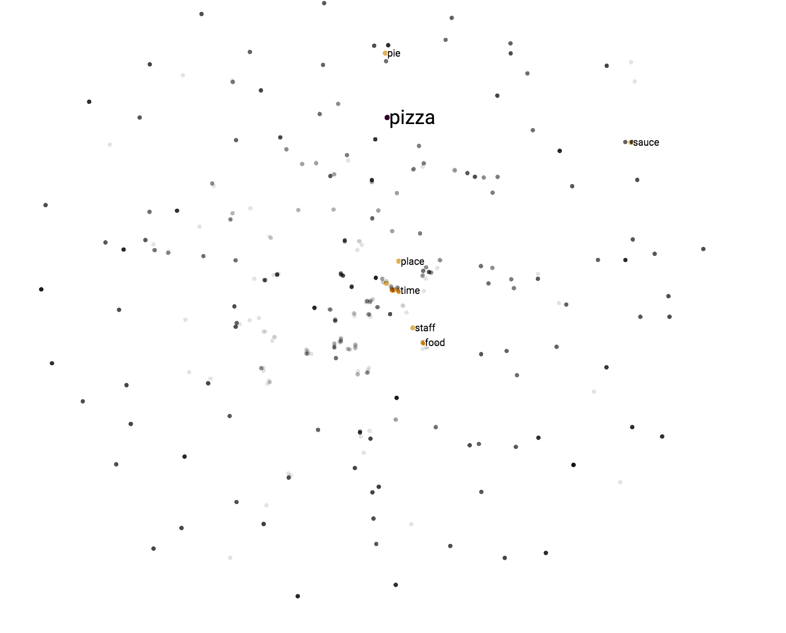
Analyze Baseline Model
Similar words of “pizza” in 2D based on LDA model

Slide 55
Analyze Baseline Model
Top ten words similar to “pizza” based on LDA model
Similar words of “pizza” (LDA) | Cosine distance | Euclidean distance
wings | 0.001 | 0.001
oven | 0.001 | 0.001
garlic | 0.024 | 0.221
sauce | 0.720 | 1.200
pie food | 0.876 0.993 | 1.323 1.409
service | 0.995 | 1.411
time | 0.996 | 1.411
wish | 0.996 | 1.411
fish | 0.996 | 1.412

Slide 56
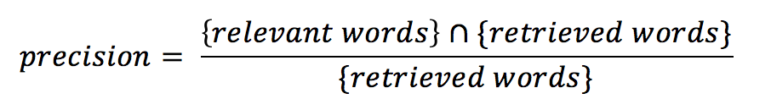
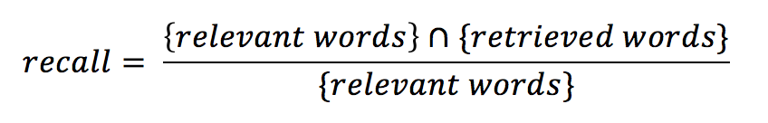
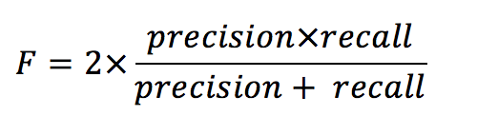
Test on Test Data
Measure Method
Precision
Recall
F score

Slide 57
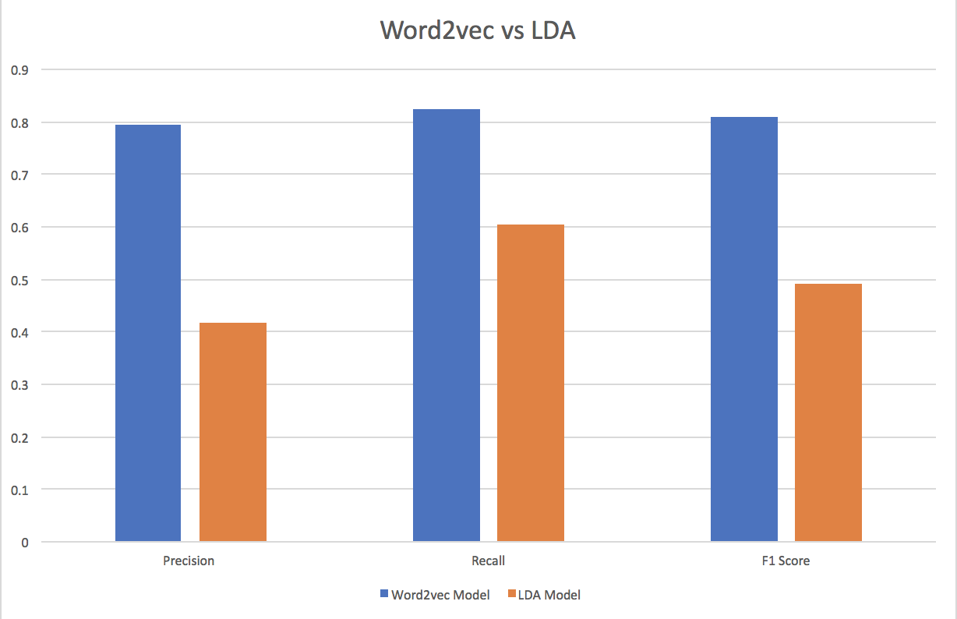
Test on Test Data
Test Result of Word2vec model and LDA model
 | Precision | Recall | F score
Word2vec Model | 0.7941 | 0.8228 | 0.8079
LDA Model | 0.4162 | 0.6038 | 0.4927

Slide 58
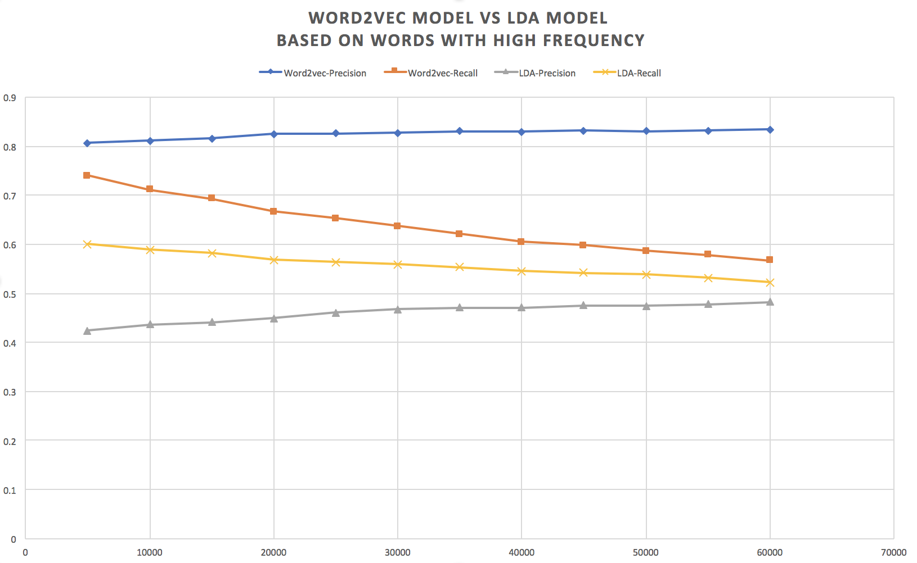
Test on Test Data

Slide 59
More things
Top 10 similar words of “yum”
Similar words of “yum” | Cosine distance | Euclidean distance
mmmm | 0.248 | 0.705
mmm | 0.273 | 0.739
mmmmm | 0.276 | 0.742
yumm | 0.291 | 0.785
yummm | 0.308 | 0.789
yummy | 0.311 | 0.797
mmmmmm | 0.318 | 0.818
Yum_yum | 0.335 | 0.823
mmmmmmm | 0.339 | 0.827
yums | 0.342 | 0.887

Slide 60
More things
Top 10 similar words of “awesome”
Similar words of “awesome” | Cosine distance | Euclidean distance
excellent | 0.161 | 0.567
phenomenal | 0.165 | 0.575
terrific | 0.210 | 0.648
wonderful | 0.239 | 0.692
superb | 0.241 | 0.694
delish | 0.275 | 0.741
awsome | 0.290 | 0.762
yummy | 0.321 | 0.801
killer | 0.338 | 0.822
delightful | 0.360 | 0.848

Slide 61
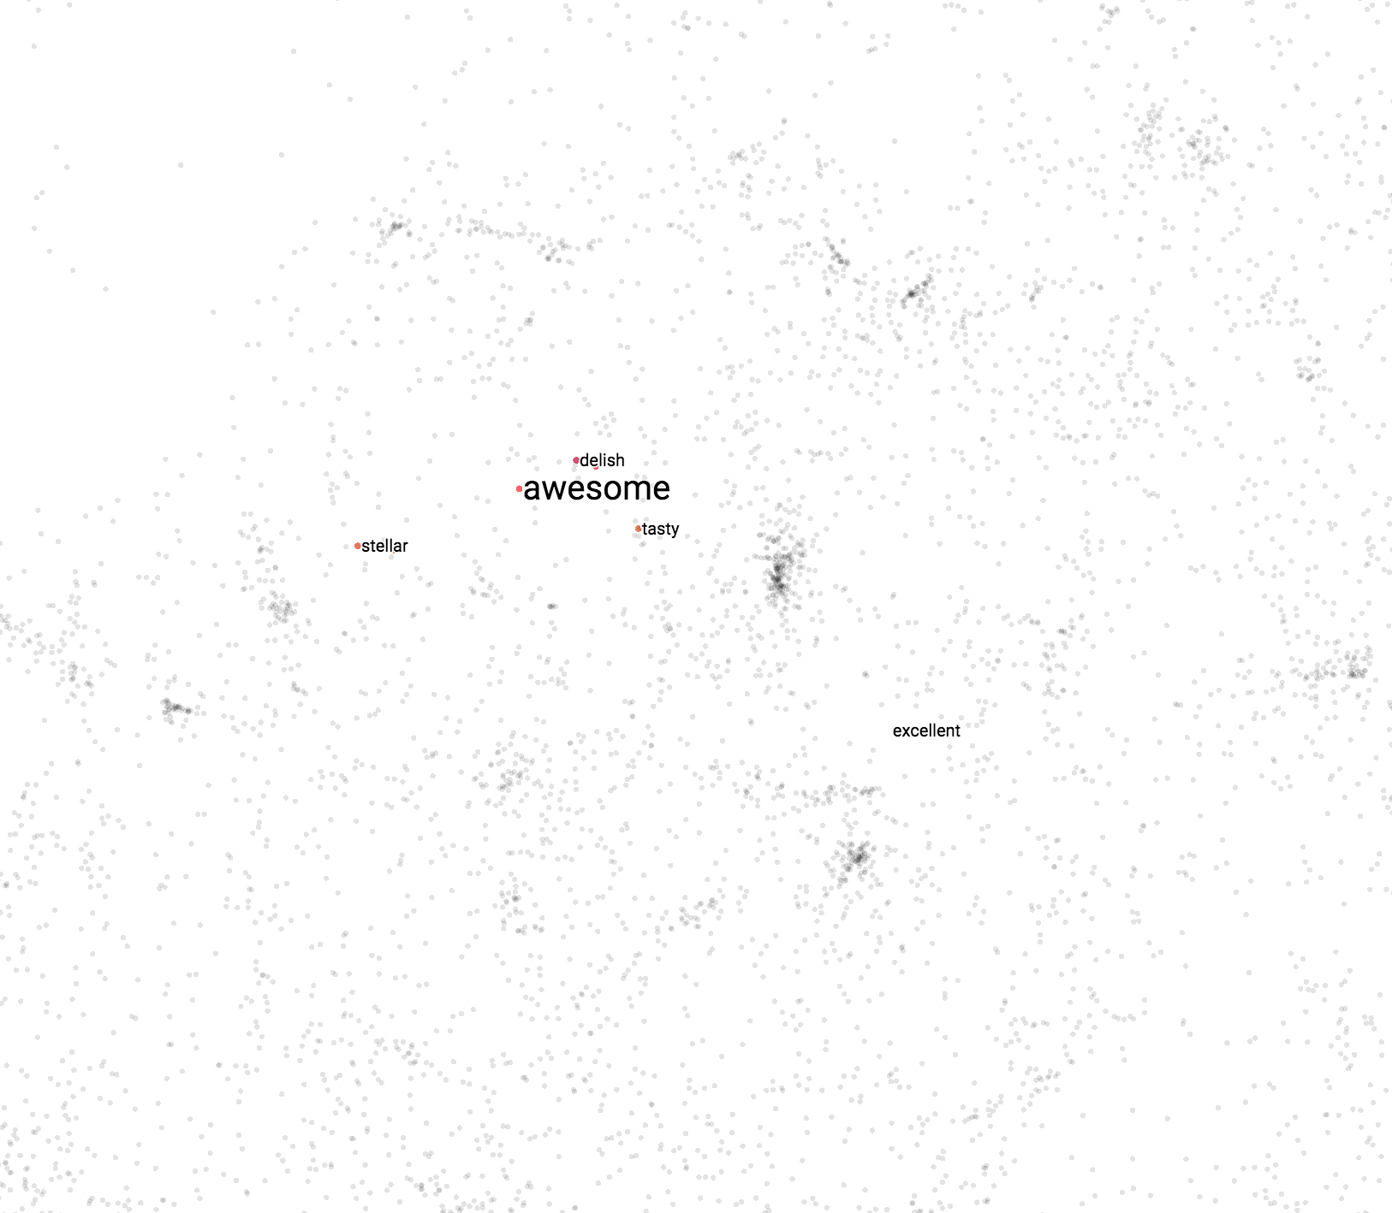
More things
similar words of “awesome”

Slide 62
More things
V(burgers)- V(burger) + V(pizza) = ?
Similar vectors of “V(burgers)- V(burger) + V(pizza)” | Cosine distance
pizzas | 0.132
calzones | 0.292
subs | 0.310
hoagies | 0.313
strombolis | 0.326
pies | 0.343
pastas | 0.376
sandwiches | 0.377
pasta_dishes | 0.397
mozzarella_sticks | 0.407
Notes:
Plurals [p le ro]

Slide 63
More things
V(Japan)- V(ramen) + V(pho) = ?
Similar vectors of “V(japan)- V(ramenr) + V(pho)” | Cosine distance
Thailand | 0.191
Taiwan | 0.214
Koera | 0.217
Hawaii | 0.231
Vietnam | 0.248

Slide 64
More things
V(Japanese)- V(ramen) + V(pho) = ?
Similar vectors of “V(japan)- V(ramenr) + V(pho)” | Cosine distance
Chinese | 0.168
Vietnamese | 0.169
Asian | 0.219
Taiwanese | 0.224
Filipino | 0.227

Slide 65
Conclusions
Works better than Baseline
Not perfect.
“Fee” and “minimum”
Detecting food categories
Detecting typos and abbreviations
Detecting informal words

Slide 66
Conclusions
Detecting typos and abbreviations
Similar words with “atmosphere” (typo) | Cosine distance
atomosphere | 0.126
enviroment | 0.127
atmospher | 0.135
atmostphere | 0.136
atmoshere | 0.139

Slide 67
Conclusions
Informal words
Similar words of “yum” | Cosine distance | Euclidean distance
mmmm | 0.248 | 0.705
mmm | 0.273 | 0.739
mmmmm | 0.276 | 0.742
yumm | 0.291 | 0.785
yummm | 0.308 | 0.789
yummy | 0.311 | 0.797
mmmmmm | 0.318 | 0.818
Yum_yum | 0.335 | 0.823
mmmmmmm | 0.339 | 0.827
yums | 0.342 | 0.887

Slide 68
Recommendations
Part of speech tagging tool
Detect sentiment adjective

Slide 69
Thank you!

